Slide 1

GEARING UP
FOR
ENHANCED
BASIC EDUCATION
(K to 12)

Slide 2


DepED Vision
We dream of Filipinos
who passionately love their country
and whose values and competencies
enable them to realize their full potential
and contribute meaningfully to building the nation.
As a learner-centered public institution, the Department of Education
consistently improves itself
to better serve its stakeholders.
-2013

Slide 3
DepED Mission
To protect and promote the right of every Filipino to quality, equitable, culture-based and complete basic education where:
Students learn in a child-friendly, gender-sensitive,
safe and motivating environment
Teachers facilitate learning and constantly nurture every learner
-2013
Notes:
<read>
Include points if the speaker wants to elaborate.

Slide 4
Administrators and staff, as stewards of the institution,
ensure an enabling and supportive environment
for effective learning to happen.
Family, community and other stakeholders are
actively engaged and share responsibility for
developing life-long learners.
-2013
Notes:
<read>
Include points if the speaker wants to elaborate.

Slide 5
DepED Core Values
Maka- Diyos | Maka- tao | Maka-kalikasan | Maka- bansa
Pananampalataya | Pagdama at pag-unawa sa damdamin ng iba | Pagpapahalaga sa kalikasan | Pananagutang panlipunan
Pag-asa | Paggalang | Pangangalaga ng kapaligiran | Pagkakapantay-pantay ng lahat ng tao
Pagmamahal | Kabutihan |  | Pagmamalasakit sa kabutihan ng nakararami
Espirituwalidad | Pagmamalasakit sa kapwa
-2013
Notes:
4 major core values of the department that all stakeholders can relate to and be accountable for.
The words or phrases below each value are components, reiterations of the above value.

Slide 6


Slide 7
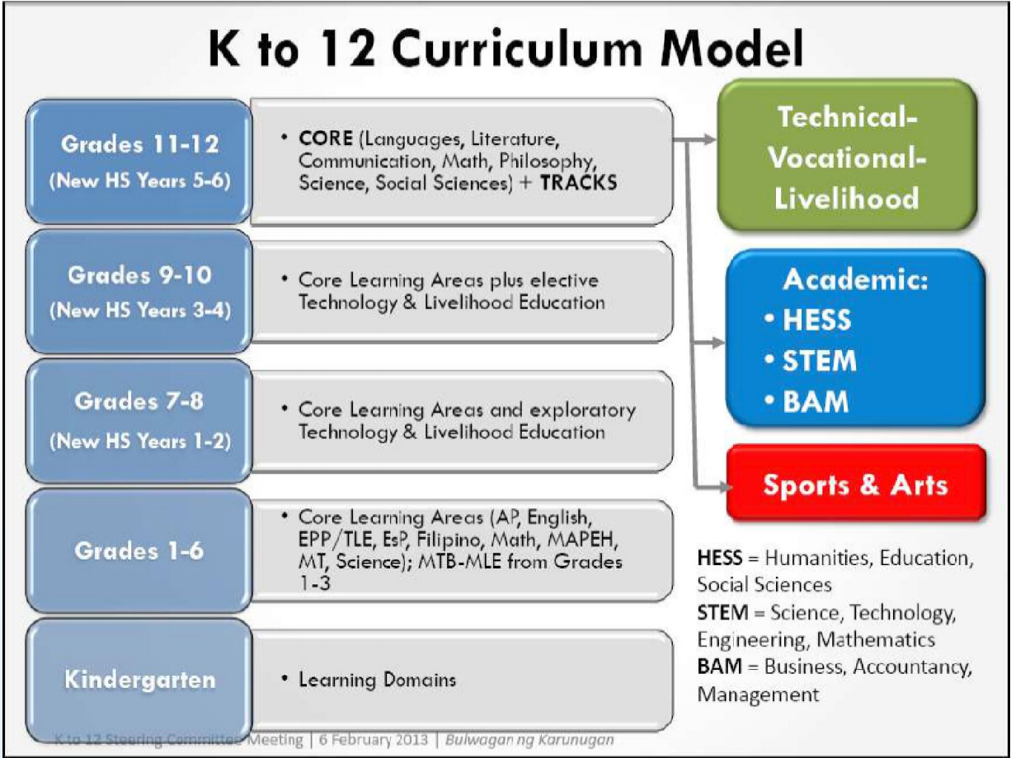

Slide 8
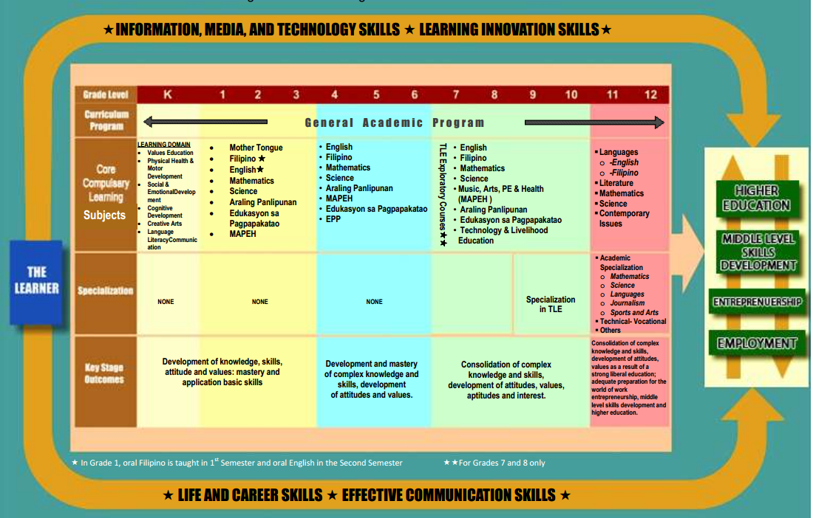

Slide 9



PHASED IMPLEMENTATION OF K TO 12
Phase 1:
Laying the Foundations
Phase 2:
Modeling and Initial Migration
Phase 3: SHS Roll-out
Phase 4:
Completion of Reform
October 2010-May 2012
June 2012-May 2016
June 2016-May 2018
June 2018-May 2023
Grades 11 and 12 implementation in public schools
Universal Kinder Implementation
Migration of Grade 1 and 7 (roll forward)
Complete migration of K to 12 basic education curriculum
SHS Modeling
Enactment of Universal Kindergarten Law
Complete migration to new elementary curriculum including Grades 5 and 6
Enactment of K to 12 Basic Education Law
K to 12
Basic Education Program
Social Development Committee—Cabinet Level Meeting/
August 15, 2011

Slide 10
Transition
The DepED, the CHED and the TESDA shall formulate the appropriate strategies and mechanisms needed
to ensure smooth transition from 10 TO K to 12 cycle.
The strategies may cover changes in:
physical infrastructure
manpower
organizational and structural concerns
bridging models linking grade 10 competencies,
-entry requirements of new tertiary curricula, and --_partnerships between the government and other entities.

Slide 11
Transition
Modeling for senior high school will be implemented
in selected schools to simulate the transition
process and provide concrete data for the transition
plan.
DepEd shall engage in partnerships with HEI and
TVIs for the utilization of the latter’s human and
physical resources.

Slide 12
Transition
The faculty of HEIs and TVIs allowed to teach students of secondary education shall be given priority in hiring for the duration of the transition period.

Slide 13
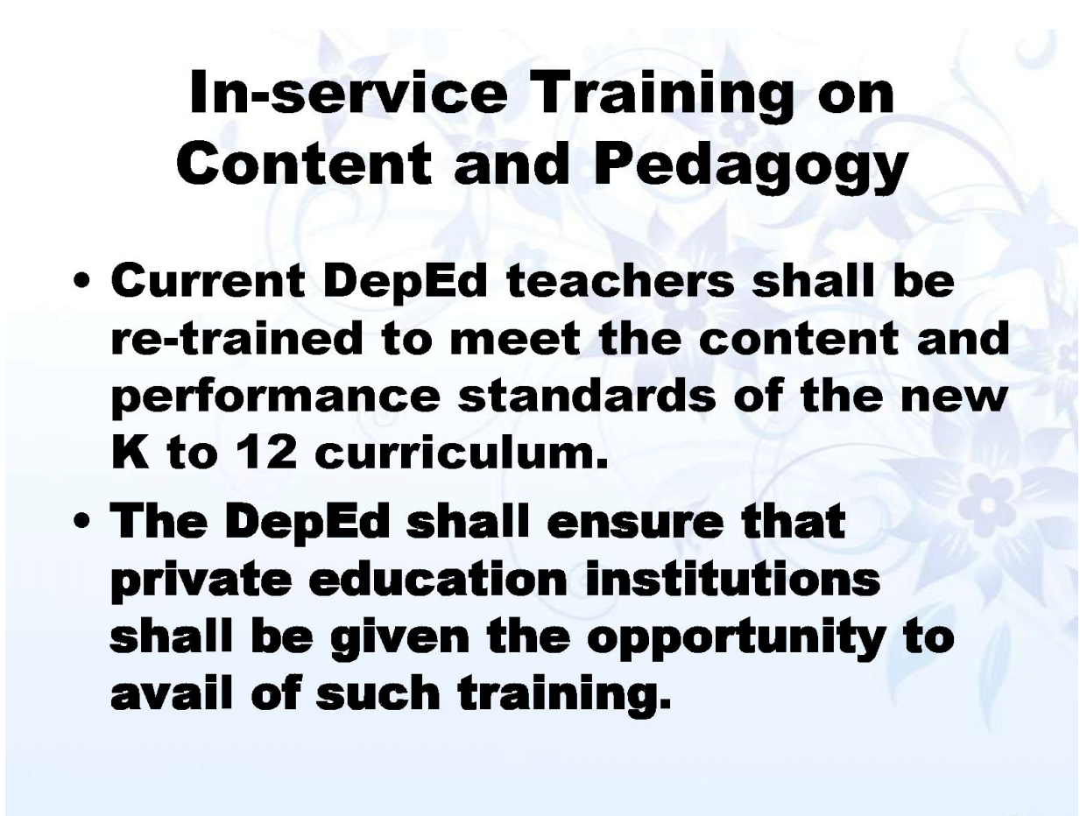
Sec. 7

Slide 14
RA No. 10533 or Enhanced Basic Education Act : full enhancement and lengthening of Basic Education in the country
School Year 2016-2017 – official implementation of SHS nationwide
Core Curriculum and Tracks
- Academic
- Technical-Vocational-Livelihood
- Sports and Arts

Slide 15
FY 2015 BUDGET PLANNING CYCLE & PRE-PLANNING FOR SHS
The Department was able to start transitioning into a more strategic, bottom-up budgeting approach for FY 2014
By the end of 2013 – Preparations and planning were done in the Central, Regional and Division Offices
January – April 2014 – plan consolidation and budget requirements
SHS Planning Guide – starting point and input for Regions and Divisions to go through the DepED Planning Process for FY 2015

Slide 16
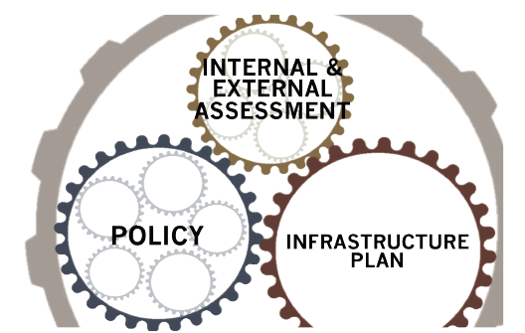
GEARING UP FOR SHS IMPLEMENTATION
Conduct internal and external assessment to ensure proper understanding of supply and demand
Assessments’ important factors: internal & absorptive capacities and market realities
Assessments are the foundation of the Infrastructure Plan

Slide 17
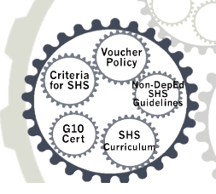
5 POLICY DECISIONS
SHS Curriculum – Technical Panels, Programs & Projects
- will be finalized by November
- will provide specific on:
a. number of hours for the core
curriculum
b. Curriculum by track
c. Strands per track
d. Facility requirements
e. Equipment requirements

Slide 18
5 POLICY DECISIONS
2. Non-DepED SHS Guidelines - Programs
and Projects
- will guide the non-DepED
schools in transitioning to SHS or
in their decision to offer SHS
- will guide partnership creation and
pave way for clear arrangements with
with potential external providers

Slide 19
5 POLICY DECISIONS
3. Voucher Policy – Finance and
Administrations
- will be the DepED’s mechanism
to implement publicly funded and
privately managed SHS
- allow the DepED to utilize available
capacity in non-DepED schools instead
of immediately building more schools
during the transition years from 2016-
2020

Slide 20
5 POLICY DECISIONS
4. Grade 10 Certificate, Grade 12
Certificate/Diploma and TESD
Implications– EXECOM and ProgCom
- will affect demand for SHS and is still
being reviewed

Slide 21
5 POLICY DECISIONS
5. Criteria for locating DepED SHS-
Regional Operations
- will depend on whether the SHS will
be an existing school or in a new school
- Factors to consider:
a. Internal capacity of the school
b. Strategic location, accessibility,
commute time, and distance
c. Potential partnerships and potential
demand creation
d. Whether certain existing schools
can still accommodate more
enrolment

Slide 22
5 POLICY DECISIONS
e. Locating potential new school sites
f. Faculty availability
g. Facility requirement and revisiting
classroom

Slide 23
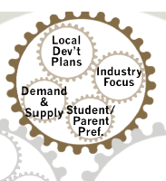
INTERNAL AND EXTERNAL ASSESSMENTS
Primary objectives:
To start creating operational plan at the regional/division level for elements we can determine now
To provide tools in creating demand projections and necessary supply for SHS provision
To start actively engaging external stakeholders, who are crucial partners in implementing SHS

Slide 24
TIMELINE & ACTION STEPS

Slide 25
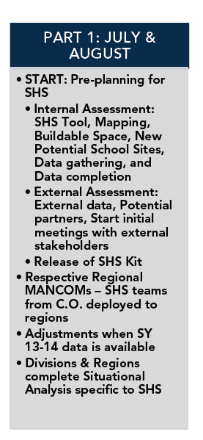
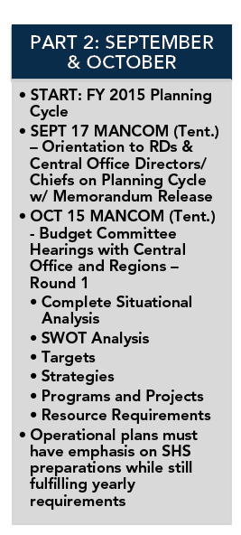
SHS PRE-PLANNING INTEGRATED WITH THE FY 2015 PLANNING CYCLE

Slide 26
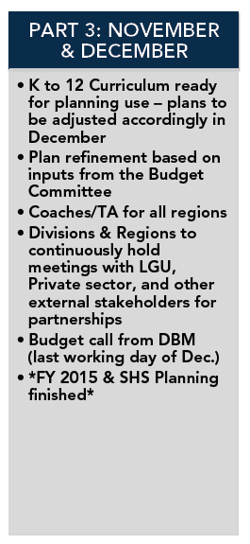
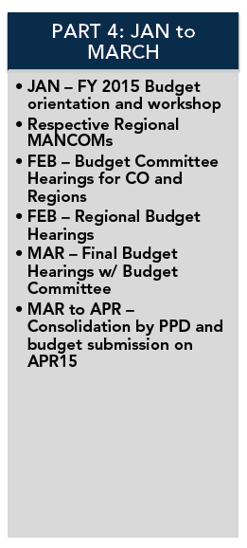
SHS PRE-PLANNING INTEGRATED WITH THE FY 2015 PLANNING CYCLE

Slide 27
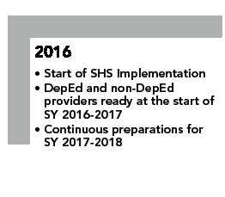
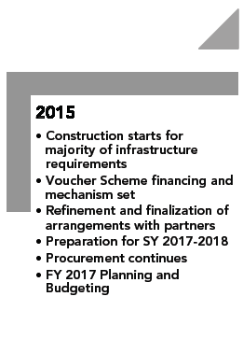
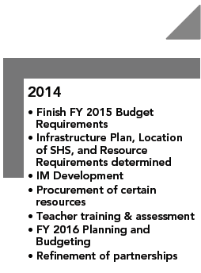
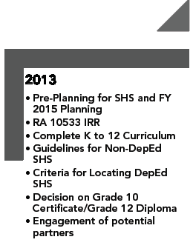
SHS IMPLEMENTATION ROADMAP TO 2016

Slide 28
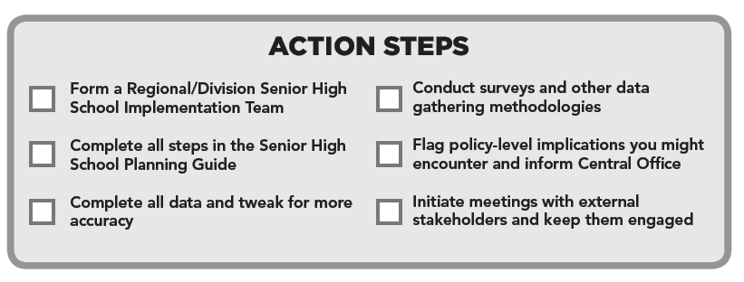

Slide 29
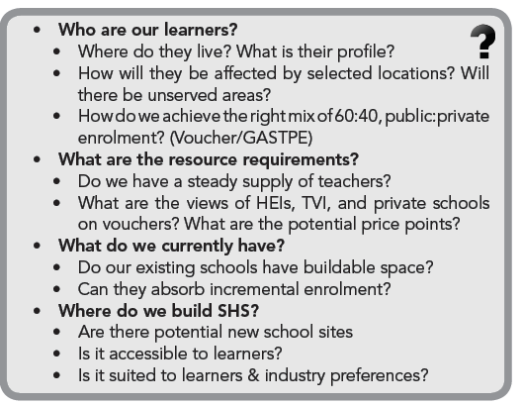
KEY QUESTIONS FOR INTERNAL ASSESSMENT

Slide 30
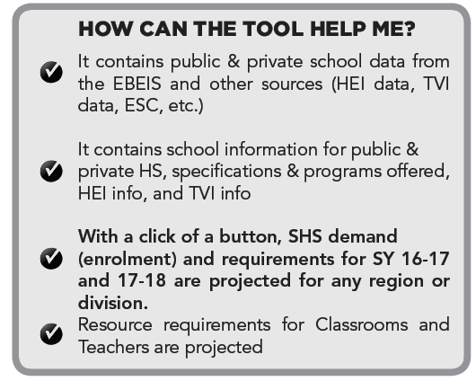
SENIOR HIGH SCHOOL PROJECTIONS (Pro) TOOL

Slide 31
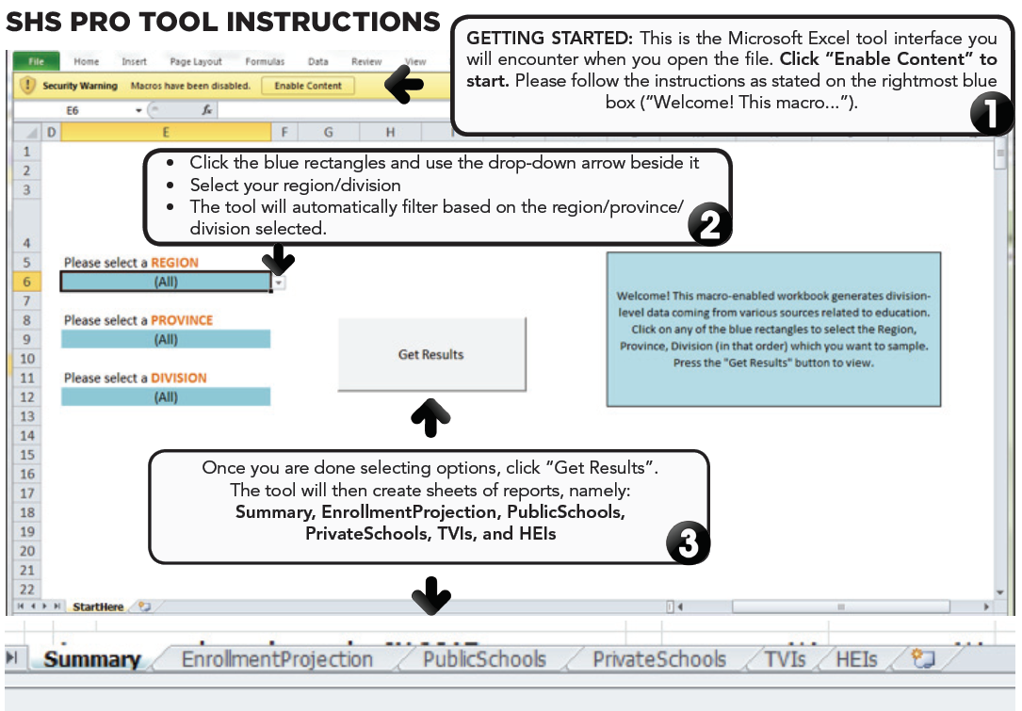

Slide 32
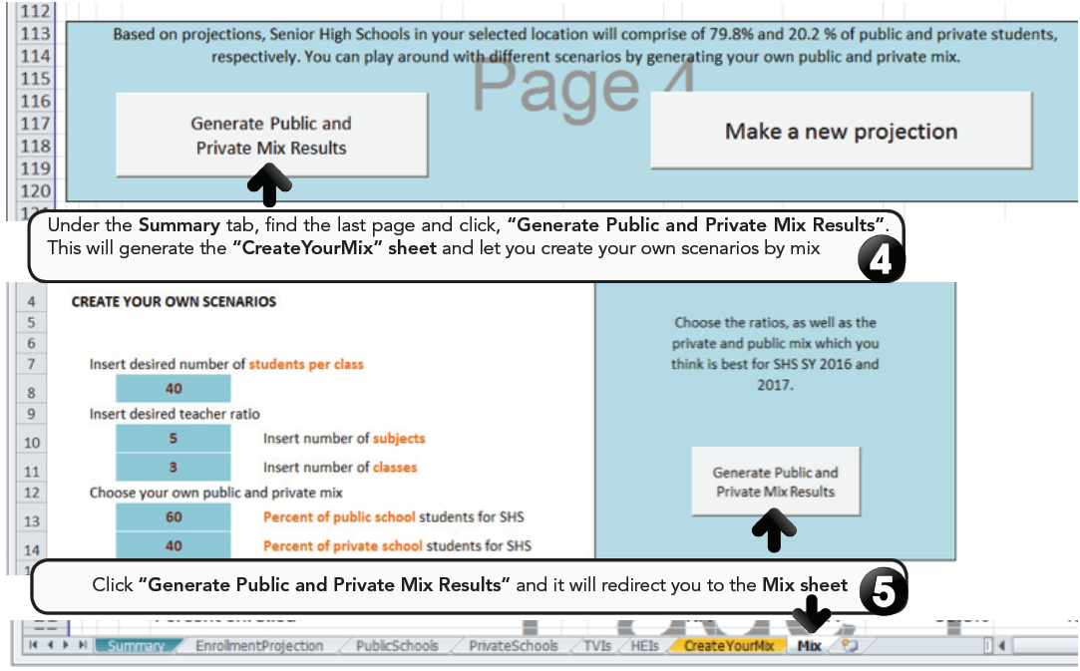

Slide 33
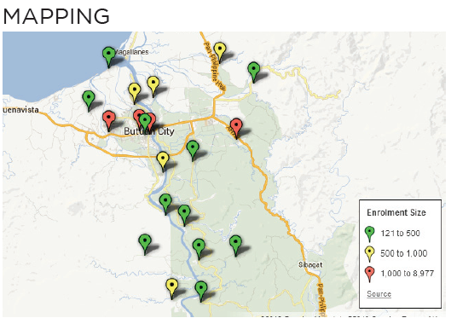
OTHER DATA & ACTION STEPS
Refer to ASEC Reynaldo D. Laguda’s letter to ICT Coordinators
(next slide)

Slide 34


Slide 35
BUILDABLE SPACE
Table C of Gov’t. Elementary School Profile for the EBEIS, is the buildable space viable for building SHS? Can each school still absorb incremental enrolment?
Identify a list of existing schools with buildable space that are viable for SHS placement while considering factors like present enrolment, classroom deterioration, disaster risks, etc.

Slide 36
Table C6. BUILDABLE SPACE FOR ADDITIONAL 7x9 CLASSROOMS,
SY 2012-2013 (As of March 31, 2013)
 | Does the school have available buildable space for additional 7x9 classrooms on a vacant lot?
 |  |  |  |  | Yes |  |  |  |  | No
 | If Yes, how many additional 7x9 classrooms can be constructed? |  |  |  |  |  |  |  |  |  |  |  |  |  |  |  | ________
BUILDABLE SPACE FOR ADDITIONAL 7x9 CLASSROOMS (Table C6)
Indicate the number of 7x9 classrooms that can be constructed in the available space in the school site.

Slide 37
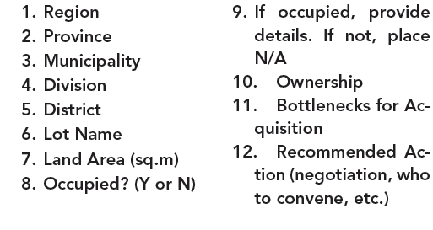
POTENTIAL NEW SCHOOL SITES
Are there potential new school sites where the Department can build SHS? Are these areas optimal and in good proximity to our learners?
Tabulate the following data

Slide 38
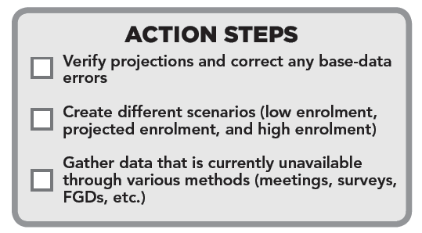

Slide 39
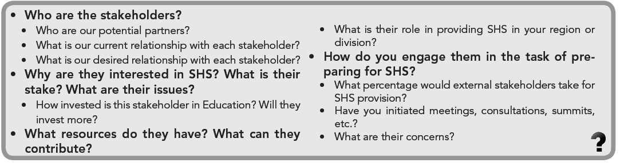
KEY QUESTIONS FOR EXTERNAL ASSESSMENT

Slide 40
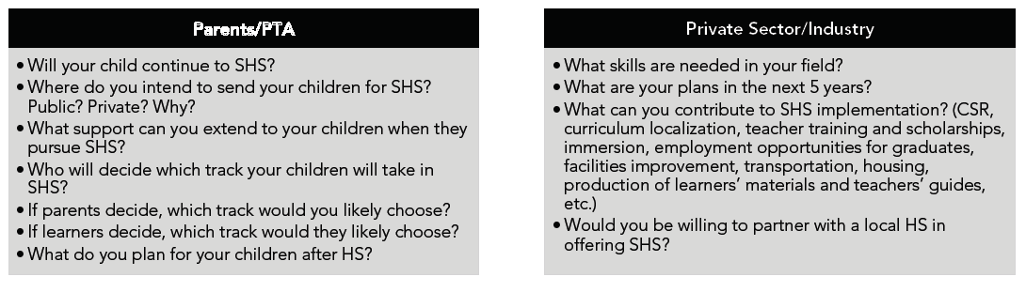
SPECIFIC QUESTIONS TO EXTERNAL STAKEHOLDERS?

Slide 41
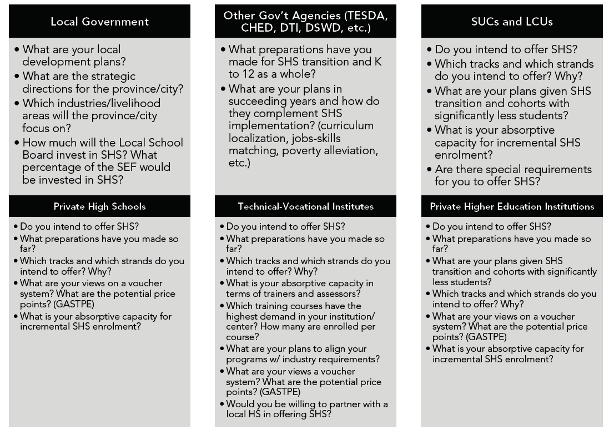

Slide 42


